Slide 1
Lesson 3.1
Variables

Slide 2

Working with variables I
You’ll need this guy ->
Write a script that:
Asks for your name
Says “Hello [your name]”
Write another script that:
Asks for your class (freshman, sophomore, junior, or senior)
Says “You are a [your class]”
Finally try to write a script that:
Asks for your name
Asks for your class
Says “Hello [your name] the [your class]”

Slide 3

Working with variables I
You’ll need this guy ->
Write a script that:
Asks for your name
Says “Hello [your name]”
Write another script that:
Asks for your class (freshman, sophomore, junior, or senior)
Says “You are a [your class]”
Finally try to write a script that:
Asks for your name
Asks for your class
Says “Hello [your name] the [your class]”

Slide 4

Working with variables I
You’ll need this guy ->
Write a script that:
Asks for your name
Says “Hello [your name]”
Write another script that:
Asks for your class (freshman, sophomore, junior, or senior)
Says “You are a [your class]”
Finally try to write a script that:
Asks for your name
Asks for your class
Says “Hello [your name] the [your class]”

Slide 5

Working with variables I
You’ll need this guy ->
Write a script that:
Asks for your name
Says “Hello [your name]”
Write another script that:
Asks for your class (freshman, sophomore, junior, or senior)
Says “You are a [your class]”
Finally try to write a script that:
Asks for your name
Asks for your class
Says “Hello [your name] the [your class]”
That doesn’t look right…

Slide 6

Working with variables I
For that last part, why couldn't I reuse for my name?
Because changed from “Bobby” to “Senior”
Why did that happen?
Because I entered a new answer with
How would you define ?
holds the last response the user entered for
Variables are like boxes:
The name of the variable, “answer”, is just a label
The value of the variable, “Bobby” / “Senior”, is what we actually use

Slide 7
Working with variables I
For that last part, why couldn't I reuse for my name?
Because changed from “Bobby” to “Senior”
Why did that happen?
Because I entered a new answer with
How would you define ?
holds the last response the user entered for
Variables are like boxes:
The name of the variable, “answer”, is just a label
The value of the variable, “Bobby” / “Senior”, is what we actually use

Slide 8

Working with variables I
For that last part, why couldn't I reuse for my name?
Because changed from “Bobby” to “Senior”
Why did that happen?
Because I entered a new answer with
How would you define ?
holds the last response the user entered for
Variables are like boxes:
The name of the variable, “answer”, is just a label
The value of the variable, “Bobby” / “Senior”, is what we actually use

Slide 9
Working with variables I
For that last part, why couldn't I reuse for my name?
Because changed from “Bobby” to “Senior”
Why did that happen?
Because I entered a new answer with
How would you define ?
holds the last response the user entered for
Variables are like boxes:
The name of the variable, “answer”, is just a label
The value of the variable, “Bobby” / “Senior”, is what we actually use

Slide 10
Working with variables I
When I enter “Bobby” as the answer, “Bobby” gets stored in a variable called answer. “Bobby” is now the value of answer.
When I enter “Senior” as the answer, “Senior” gets stored in answer and is the new value.
What happens to “Bobby”? The old value is gone forever.
“Bobby”

Slide 11
Working with variables I
When I enter “Bobby” as the answer, “Bobby” gets stored in a variable called answer. “Bobby” is now the value of answer.
When I enter “Senior” as the answer, “Senior” gets stored in answer and is the new value.
What happens to “Bobby”? The old value is gone forever.
“Bobby”
“Senior”

Slide 12
Working with variables I
When I enter “Bobby” as the answer, “Bobby” gets stored in a variable called answer. “Bobby” is now the value of answer.
When I enter “Senior” as the answer, “Senior” gets stored in answer and is the new value.
What happens to “Bobby”?
“Bobby”
“Bobby”
“Senior”

Slide 13
Working with variables I
When I enter “Bobby” as the answer, “Bobby” gets stored in a variable called answer. “Bobby” is now the value of answer.
When I enter “Senior” as the answer, “Senior” gets stored in answer and is the new value.
What happens to “Bobby”? The old value is gone forever.
“Bobby”
“Bobby”
“Senior”
“Bobby”

Slide 14
Working with variables I
How could we prevent “Bobby” from getting lost forever?
By putting it in another variable!
We create a new variable name and set its value to “Bobby”
Now when the value of answer gets set to “Senior” its safe to throw away the value “Bobby” since it’s saved in name

Slide 15
Working with variables I
How could we prevent “Bobby” from getting lost forever?
By putting it in another variable!
We create a new variable name and set its value to “Bobby”
Now when the value of answer gets set to “Senior” its safe to throw away the value “Bobby” since it’s saved in name
“Bobby”

Slide 16
Working with variables I
How could we prevent “Bobby” from getting lost forever?
By putting it in another variable!
We create a new variable name and set its value to “Bobby”
Now when the value of answer gets set to “Senoir” its safe to throw away the value “Bobby” since it’s saved in name
“Bobby”
“Bobby”
“Senior”
“Bobby”

Slide 17
Working with variables I
Try that last part again, write a script that:
Asks for your name
Asks for your class
Says “Hello [your name] the [your class]”

Slide 18
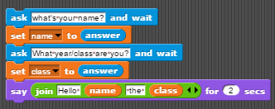
Working with variables I
Try that last part again, write a script that:
Asks for your name
Asks for your class
Says “Hello [your name] the [your class]”
Class wasn’t needed, but it’s a good habit to get into to always save user input to a variable

Slide 19
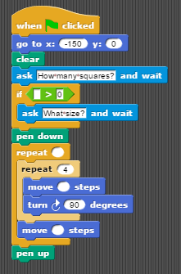
Working with variables II
Modify this script to draw the correct number of squares of the correct size based on user input

Slide 20
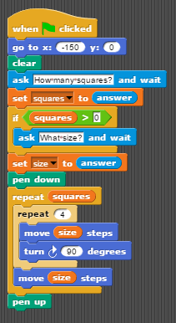
Working with variables II
Modify this script to draw the correct number of squares of the correct size based on user input

Slide 21
Working with variables III
Write a SNAP script that moves a sprite from a top down view.​ The sprite should always be facing the direction it is moving.
up arrow = move up 1 steps​
down arrow = move down 1 steps​
right arrow = move right 1 steps​
left arrow = move left 1 steps​
Let’s speed this guy up, add a boost button
space = glide 1 secs 100 steps in current direction

Slide 22
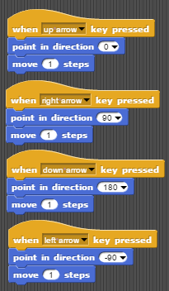
Working with variables III
Write a SNAP script that moves a sprite from a top down view.​ The sprite should always be facing the direction it is moving.
up arrow = move up 1 steps​
down arrow = move down 1 steps​
right arrow = move right 1 steps​
left arrow = move left 1 steps​
Let’s speed this guy up, add a boost button
space = glide 1 secs 100 steps in current direction

Slide 23
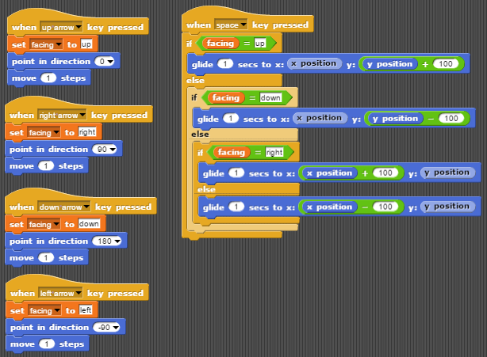
Working with variables III

